Slide 1
Synthesis
Computational Social Science
Lecture 10

Slide 2
Overview
Social science deals with complex problems
Revisit ideas from Lecture 1
Computational social science provides a set of methods that are suited to complex problems
Combine data and complexity-aware theory
Compare how methods incorporate complexity
Complexity methods: to statistical models
Four focus methods: to each other

Slide 3


One thing…
At the end of lecture, I will ask you
Something(s) you learned in this module that you think is important
Something(s) you learned in this module that you found interesting
It would be great if you can think of more than one!
Giving you some warning so you can think about it

Slide 4
Particularly important to not read ahead this week

Slide 5
Complex Realism
It is a nuisance, but God has chosen to give the easy problems to the physicists.
Lave & March (1993). An Introduction to Models in the Social Sciences. University Press of America. Lanham, MD

Slide 6


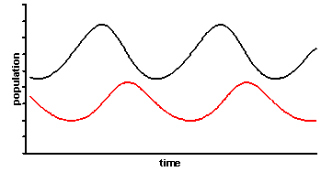
Weaver’s organisation of scientific problems
Phase 1: to 1900
Physical sciences
Problems of simplicity
Experimental methods isolate and compare
Technological advancement
Life sciences
Classify and describe
Phase 3: after 1948
Organised complexity: sizeable number of factors which are interrelated into an organic whole
Common in social and life sciences
Require
Computing power
Multidisciplinary teams
Phase 2: to 1948
Problems of disorganised complexity
Statistical methods effective as average meaningful
Weaver (1948). "Science and Complexity". American Scientist, 36(4): 536-44

Slide 7
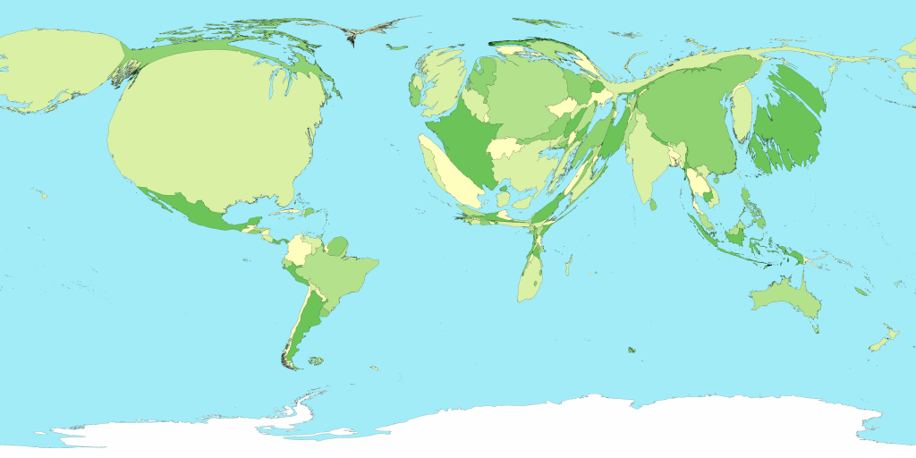
Current social problems less amenable to traditional methods
Global population overload
Global warming and climate change
Increasing ecological challenges – access to water, food
Entrenched inequality, within and between countries
Cultural conflict and terrorism
Fast moving epidemics, pandemics
Fragile infrastructure such as supply chain breakdowns

Slide 8
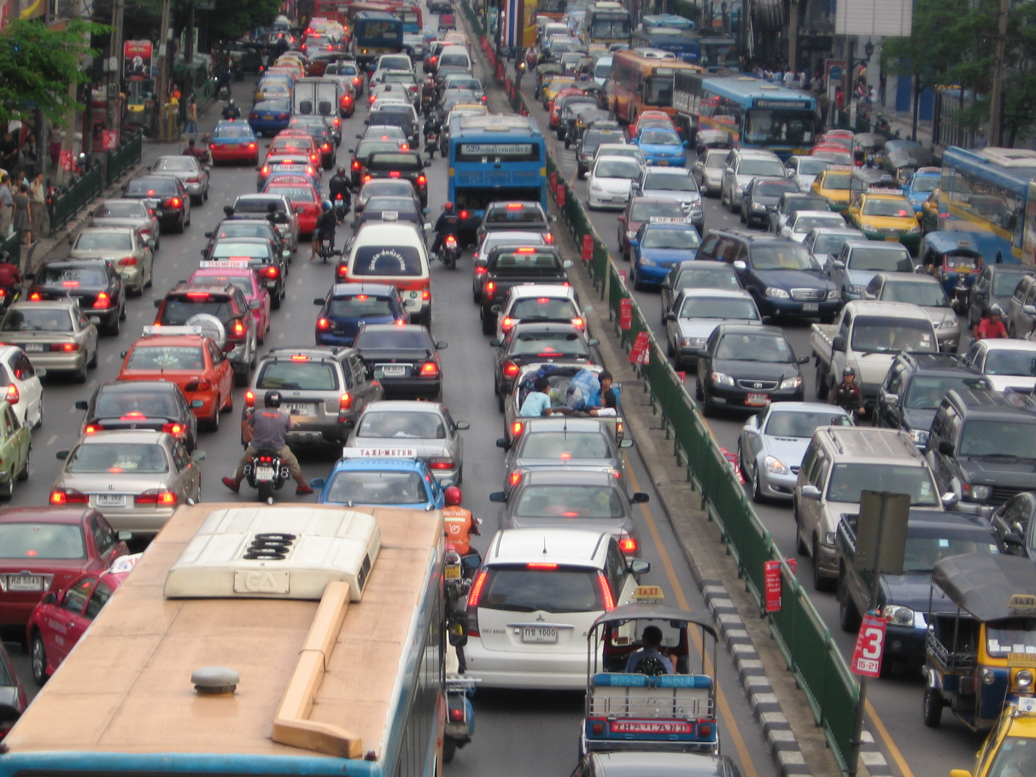
Social problems are qualitatively different: complex
A system is complex if the system's behaviour of interest is driven by the interactions between the individual parts, not simply the behaviour of the parts independently.
Something ‘more’ than having many parts that are linked in complicated ways

Slide 9
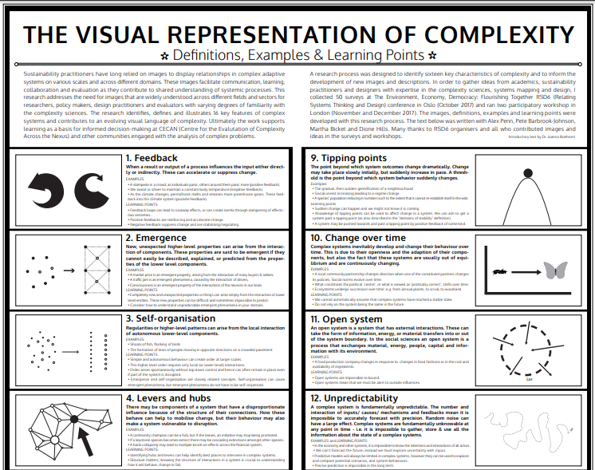
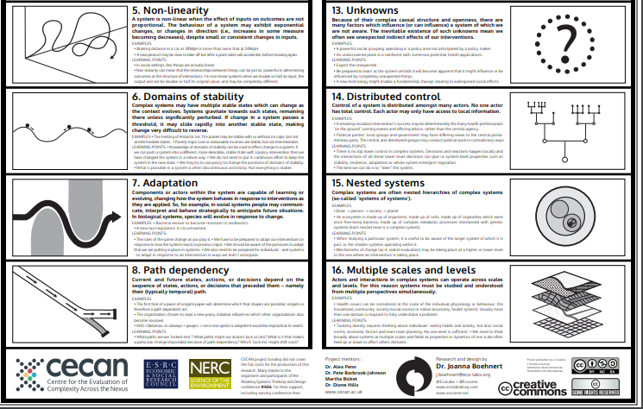
Interaction at the core of complexity gives rise to characteristic properties
Boehnert (2018). “The Visual Representation of Complexity". Proceedings of Relating Systems Thinking and Design (RSDX) Symposium

Slide 10
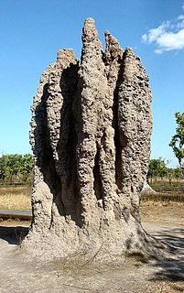
Complex systems involve Collective Behaviour
Emergence
Self-organisation
Formal term for the system having properties that the parts do not have
The system exhibits order
Parts (entities) are autonomous, without central control

Slide 11
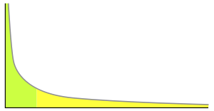
Complex Systems involve Feedback
Non-linearity
Path-dependency
Small changes with large effect
Entities adapt to the context
Phase changes
System memory (temporal interaction)
Sensitivity to initial conditions
Non-negligible chance of large event

Slide 12
Complex systems difficult to understand and predict
Fundamental Uncertainty
Emergence
Self-organisation
Non-linearity
Path dependency

Slide 13
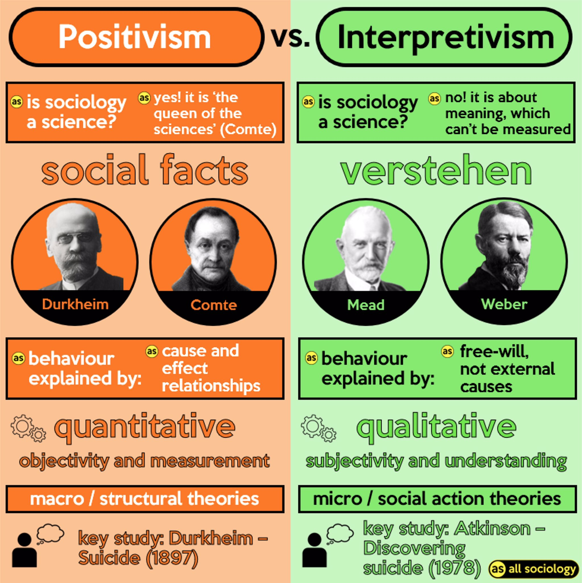
Positivism and Empiricism
The role of social science is to uncover the rules that govern the social world
Emulates natural sciences with proof, methods
Experience, observation are only source of knowledge
These rules describe the way in which the macro-structure and norms of society lead to the behaviour of people
Attributes of individuals (eg gender) expose them to different norms
Positivists (unlike strict empiricists) allow logic to supplement observation
Twitter @allsociology (11 Feb 2020)
https://twitter.com/allsociology/status/1227133621984792576

Slide 14
Interpretivism and Constructivism
Multiple realities
Individuals experience and understand the same event differently
Interpretivism: How are these realities experienced and perceived?
People are experts in their own reality
Constructivism: How are realities constructed through interaction with others?
Twitter @allsociology (11 Feb 2020)
https://twitter.com/allsociology/status/1227133621984792576

Slide 15

Complex Realism
Realism lies between positivism and interpretivism
There is a real social world to measure and understand that exists independently of our minds (Positivism)
Otherwise could not get things wrong (Sayer 2000)
Actions have an effect on society (Constructivism)
Combines quantitative and qualitative methods
That real social world is complex
Social structures emergent property of social relations
Social systems are open and evolve

Slide 16
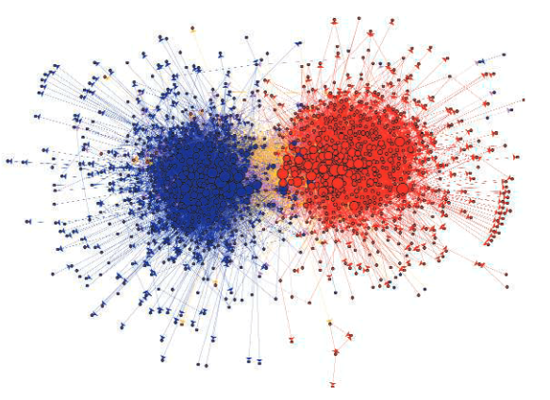
What is computational social science?
Lazer et al (2009), Computational Social Science
doi: 10.1126/science.1167742

Slide 17
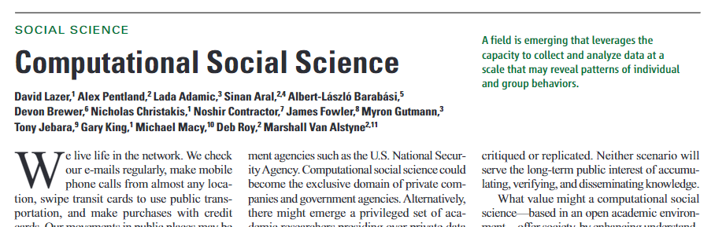
Competing definitions of CSS: Lazer et al
Lazer et al (2009), Computational Social Science
doi: 10.1126/science.1167742
Substantial social data available
Communication networks
Social media
Contents of searches
Virtual worlds for experiments
Why not (yet) transformed social science
Privacy concerns
Limited resources
Interdisciplinary: training, academic careers, journals

Slide 18

Competing definitions of CSS: Conte et al
Conte et al (2012), Manifesto of computational social science. doi: 10.1140/epjst/e2012-01697-8
Formidable social problems
Digital and data are changing society
Generative explanations combine theoretically based models with data
Primarily about ABM
Many scientific challenges
How much detail in agents?

Slide 19
Much in common…
Lazer et al
Potential of big data for social science
Digital traces of individual and group behaviour
Enormous scale of the available data
Similar data sources
Opportunity to apply quantitative methods to understand society
Data science provides methods
Interdisciplinary: social science and data science
Conte et al

Slide 20
… but fundamentally different
Lazer et al: Applying data science methods to social data
Data driven analysis of patterns of behaviour
… leverages the capacity to collect and analyze data at a scale that may reveal patterns of individual and group behaviors
Conte et al: using computational methods to do social science
Explicit integration of analysis with theory and complexity
… unprecedented volumes of data … opens up exciting new opportunities to work towards a quantitative understanding of our complex social systems
What I think of as social analytics
This module

Slide 21

Is someone analysing Facebook friend data doing social science?
If yes, why?
If no, why not?
About social interactions and behaviour
Can research phenomena such as diffusion, conformity, opinion change, characteristics of groups of interest
No meaning defined by friendship
Social science connects to some theory
Analysis is primarily descriptive
Ultimately, depends on the research question: what is the purpose of the analysis?

Slide 22

CSS is quantitative, but different from statistics
2010 ESRC review of UK sociology found
Weak training in quantitative methods compared to US tradition
Statistics core to social science
Byrne’s commentary
Agree more quantitative needed
Review equated that to statistics
Methods must deal with complexity
Statistical methods do not

Slide 23
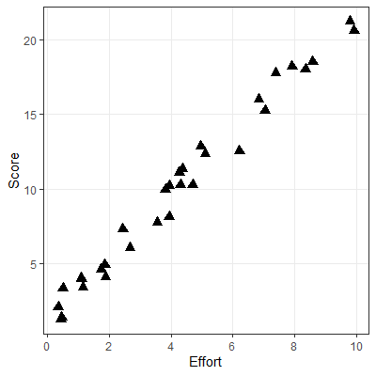
Explanation with linear statistical modelling
How would you summarise the attributes of these cases?
People who put in only a small amount of effort achieve a low score, and those who put in a large effort achieve a high score
Each additional amount of effort is associated with the same increase in score
Linear: constant increase regardless of effort

Slide 24
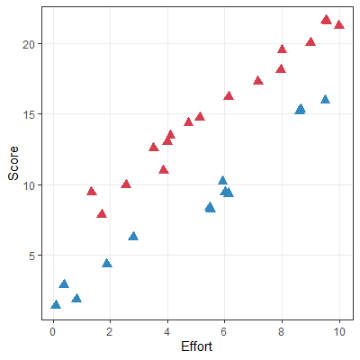
Explanation with multiple relevant attributes
How would you summarise the attributes of these cases?
As before, score related to effort
Additional factor indicated by colour
Those marked as red have consistently higher scores for same effort
Additive and independent: additional score for red is constant regardless of effort

Slide 25
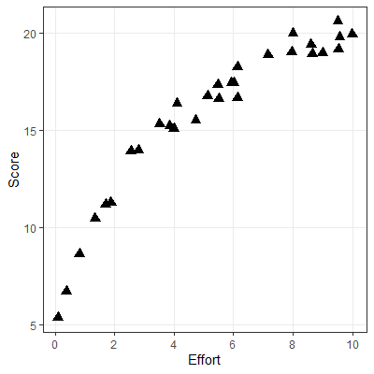
Explanation with nonlinear statistical modelling
How would you summarise the attributes of these cases?
Score increases with effort
After a certain amount of effort, each additional amount of effort has smaller impact
More complicated mathematical relationships are possible, but all have a single equation to set out how the value of one attribute is estimated by some combination of the values of all others

Slide 26
Difference in type of explanation most evident for QCA
Cases that are irrelevant in the logical structure of QCA would reduce the explanatory power of statistical model
Example: (from lecture) of hypothetical austerity protests
Subset of cases with severe austerity
Rapid price rise sufficient to protest
Protests without rapid price rise undermine statistical explanation
Rapid price rises | Protests
Rapid | Yes | No
T | 23 | 0
F | 6 | 7

Slide 27

Explanation in complex realism
In Complex Realism effects are
Complex: involve interactions between multiple factors
Emergent: cannot be reduced to individual factors or elements
Contingent: function differently depending on context
Cannot be described by some mathematical relationship between values of attributes

Slide 28
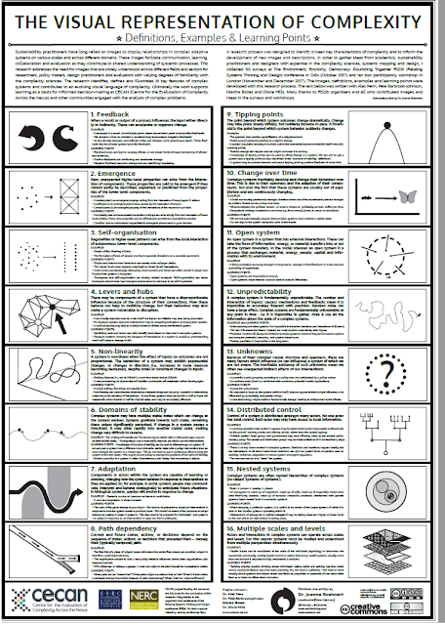
Dealing with complexity
Boehnert (2018). “The Visual Representation of Complexity". Proceedings of Relating Systems Thinking and Design (RSDX) Symposium
https://rsdsymposium.org/the-visual-representation-of-complexity-definitions-examples-learning-points/

Slide 29
How do the four methods deal with complexity?
Identify 2 or 3 complex realism aspects for each method
Clustering (case based)
QCA (configurational)
Network analysis
Simulation
Note
Also consider interactions
Characteristics are dynamic, but methods also static
Small groups

Slide 30
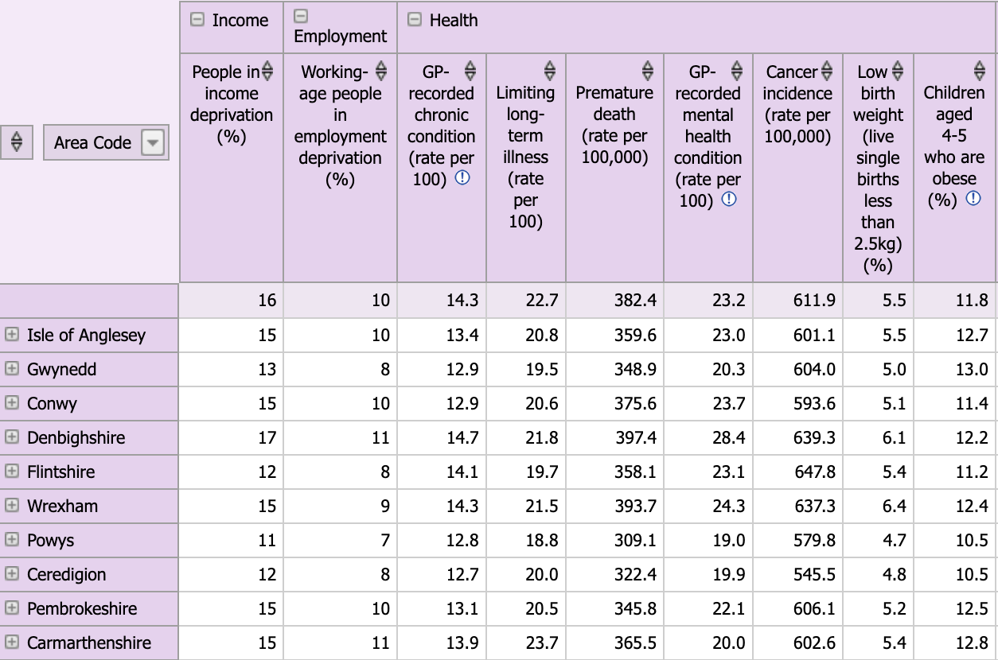
Clustering: Key Idea
Find patterns in cases based on their whole set of attributes
Also referred to as case-based complexity
Workshop case study: Criminology
Patterns of arrests in USA States
Case →

Slide 31
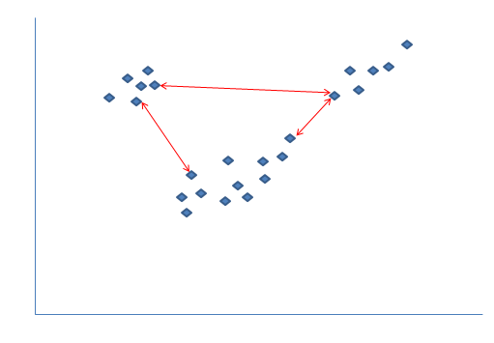
Clustering: Steps
Normalise data
Choose appropriate distance measure
Use a clustering algorithm
Group close cases into a cluster
Maximise separation between clusters
Assess whether the clusters are meaningful
Visualise
Interpret

Slide 32
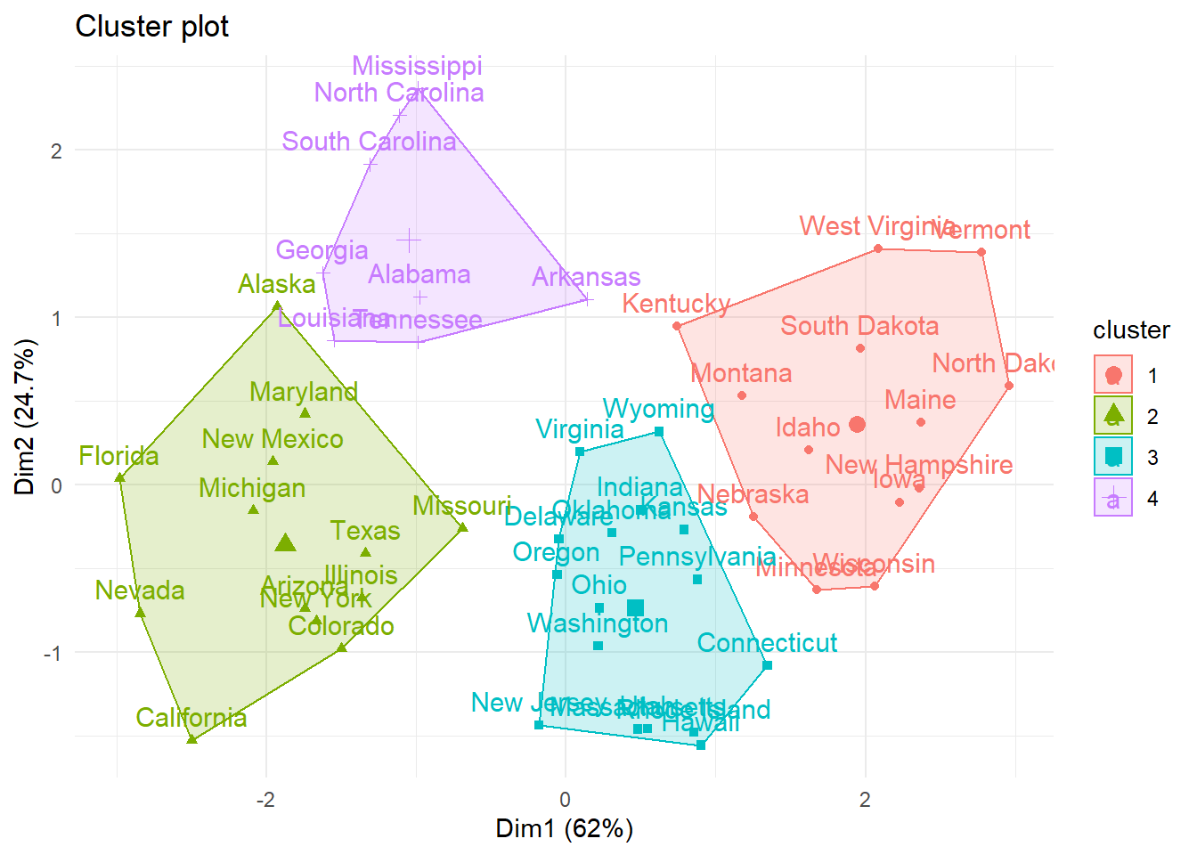
Clustering: Challenges
Only relevant for scale data attributes
Relies on mapping attributes to coordinates in spatial dimensions
Easy to obtain spurious results
Algorithms work whether or not structure exists

Slide 33
Clustering: Complexity
Emergence: cases treated as complete entities
Close on all dimensions, not just some
Self-organisation
Structure is revealed by the method
Multiple scales and levels
Small clusters may occur within broader clusters

Slide 34
QCA: Key Idea
Cases with outcome Y
Structured method for case based comparative research
Select attributes that appear to be relevant
Compare attribute patterns where the phenomenon occurs and where it doesn’t
Also referred to as configurational complexity
Workshop case study: Political Science
Explain survival/breakdown of democracy
Y
A
B
Cases with conditions A and B

Slide 35
QCA: Steps
Identify social phenomenon and potential contributing conditions
Select moderate number of cases
Calibrate attribute values
Construct truth table
Resolve contradictions
Simply truth table
May include configurations without cases
Assess quality of solution
Conditions |  | Cases by outcome
A | B | Y | ➢Y
T | T | ≥1 | 0
T | F | any | ≥1
F | T | any | ≥1
F | F | any | any

Slide 36

QCA: Challenges
Diverse cases are essential
The logic of comparing sets of truth values relies on many combinations available from the dataset
Too many remainders limit the opportunity to identify recipes
Operationalising attributes (crisp or fuzzy) relies on judgement and iteration

Slide 37
QCA: Complexity
Emergence: cases treated as composite of their attributes
Non-linearity: Recipes use logical operators
Levers and hubs: Causal recipe is lever for outcome
Recipes respect diversity and heterogeneity of the cases and their contexts
Adaptation?
Recipes have a close relationship with theory
Realist perspective, something exists to influence observations

Slide 38
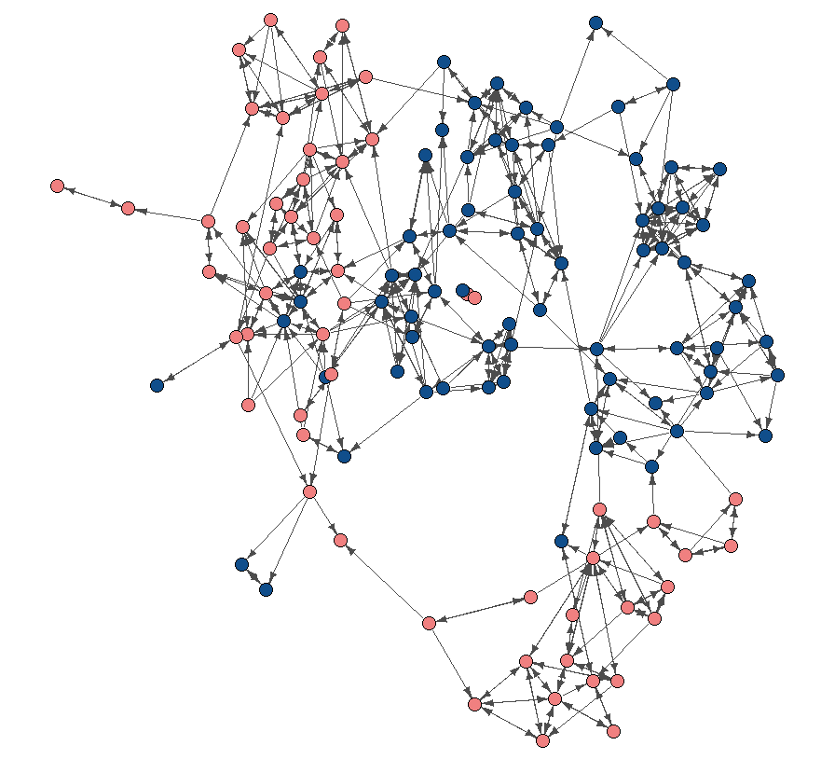
Networks: Key Idea
Relationship between cases is focus of analysis
Network analysis provides a set of tools to extend our intuition of the patterns that construct social structure
Visualise to highlight patterns and structure
Develop theories about the way in which relationships influence social phenomena and processes
Empirically test such theories
Workshop case study: Sociology
Diffusion of family planning practices

Slide 39
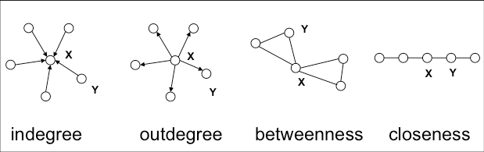
Networks: Steps
Many different methods with different steps
Collect information about cases and the relationships
Construct network
Understand the network
Visualise with attributes and layout
Calculate centrality and other properties
Consider communities

Slide 40
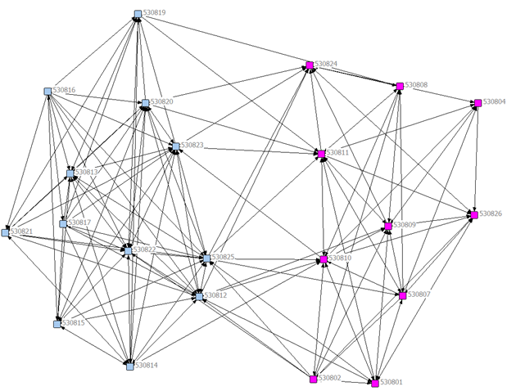
Networks: Challenges
Terminology
Two (or three) traditions
Entire discipline, not just one method
Sensitive to data quality issues
Missing cases/attribute data
Misattribution of information and relationships
Retrospection error: recalling interactions
Imagine if this node (and its edges) is missing

Slide 41
Network: Complexity
Specifically maps interactions as relationships
Levers and hubs: Influence arises from network position
Non-linearity and tipping points
Dynamics over networks (eg epidemics)
Path dependency: Which edges are involved in a relationship, not just how many
Multiple scales and levels: Analyse at node, community, whole of network

Slide 42





Simulation (ABM): Key Idea
Modelling some social process
Justified stories are plausible coherent explanations of a dynamic phenomenon
Agent-centric thinking
I, the agent, have certain characteristics and beliefs of my own as well as information about the world around me, and therefore will decide on some action
Workshop case study: Social Psychology
Conformity and segregation
$$P\left(deterrence\right)={1−\left(1 −d\right)}^{G}$$
d is deterrence per guardian
G is number of guardians

Slide 43
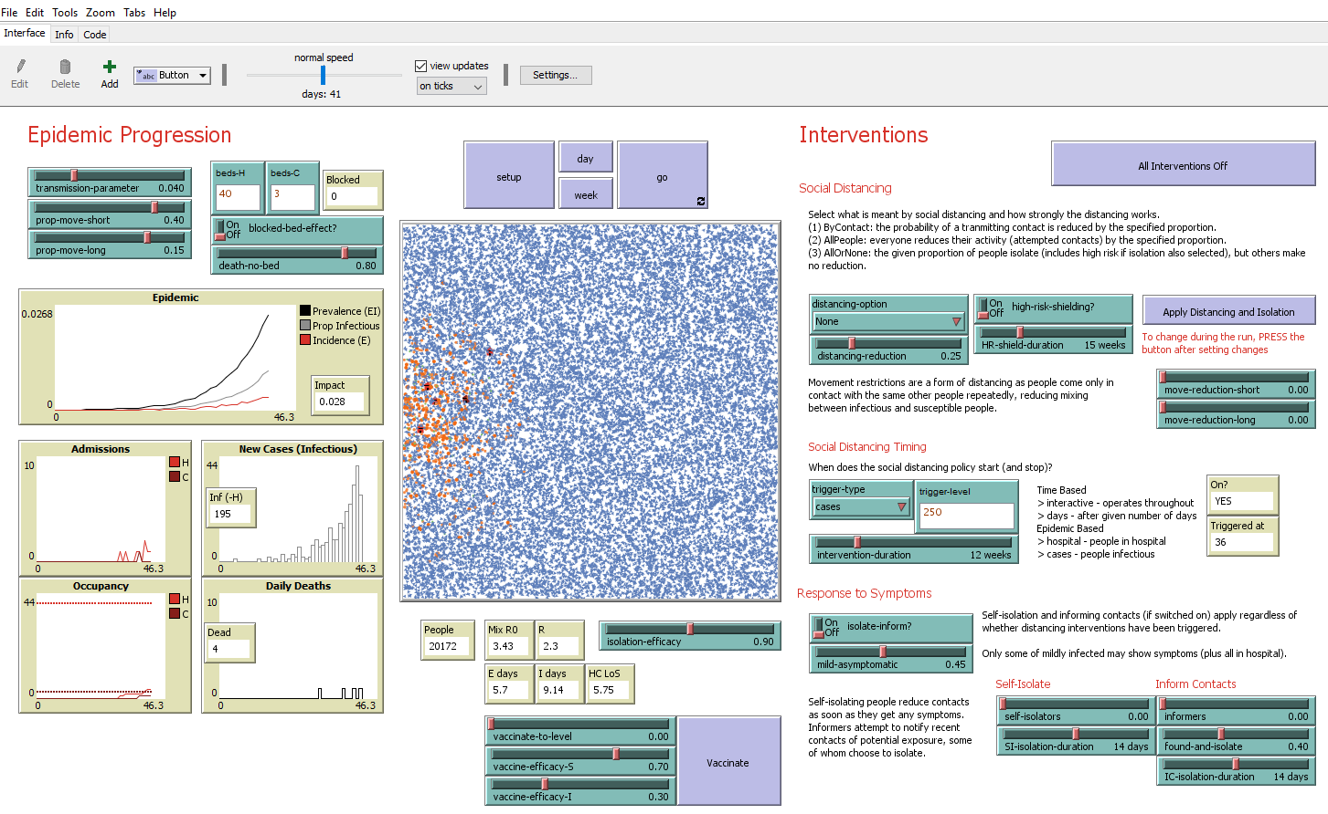
Simulation: Steps
Relevant entities
Agents, Environment, Attributes
Develop rules
How do agents behave?
Influences on that behaviour and effect of decision
Build model, testing iteratively
Run scenarios (experiments)

Slide 44

Simulation: Challenges
Process or mechanism orientation
Different type of thinking about theory and data
Data not available about mechanism, only outcomes
Balance between simplicity and detail
Programming skills

Slide 45
Simulation: Complexity
Agents interact with each other (social environment) and with their physical environment
Choice of action affected by environment and selected action has impact on the environment
Dynamic interactions
Feedback / Tipping Points / Path Dependency
Change over time / Non-linearity
Distributed control: definition of agent

Slide 46
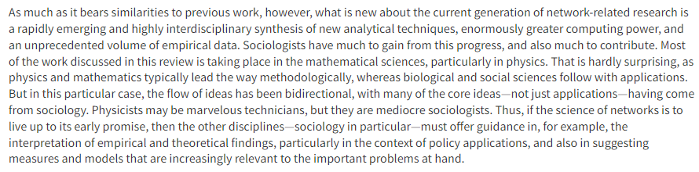
Theory and method work together
Computational Social Science is truly interdisciplinary
Mathematical/computer scientists have analytical skills and training to develop methods and work with data
Social scientists bring ideas, applications and interpretation
Theory organises the ideas and interpretation
Watts (2004), The “New” Science of Networks,
Annual Review of Sociology. 30:1, 243-270

Slide 47
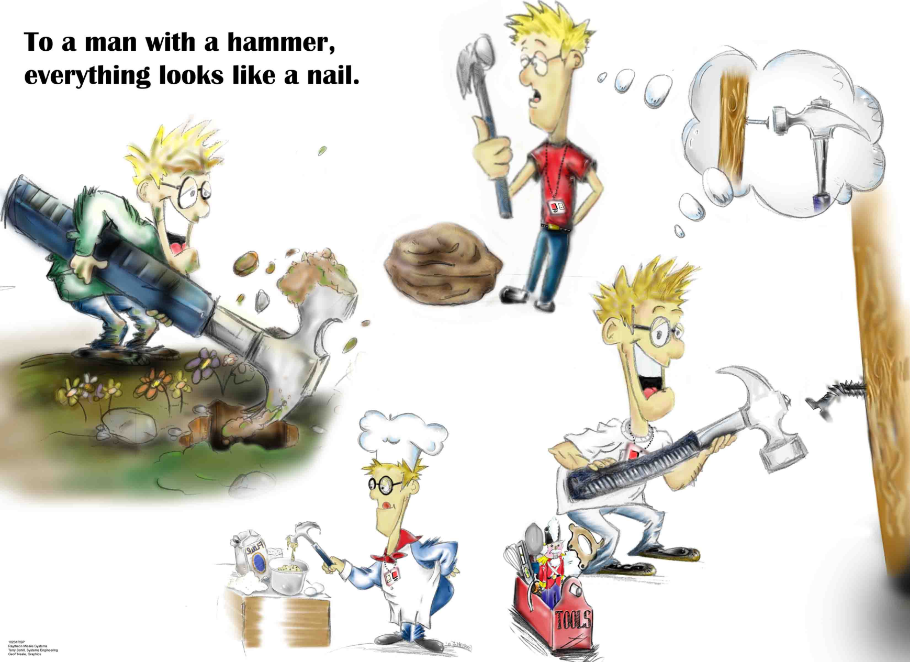
Question first, then select the method
Each computational method responds to different aspects of complex systems
Choosing a method asserts something about the structure of the system being examined and the validity of specific types of questions

Slide 48
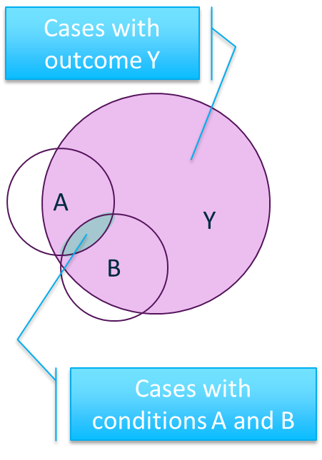
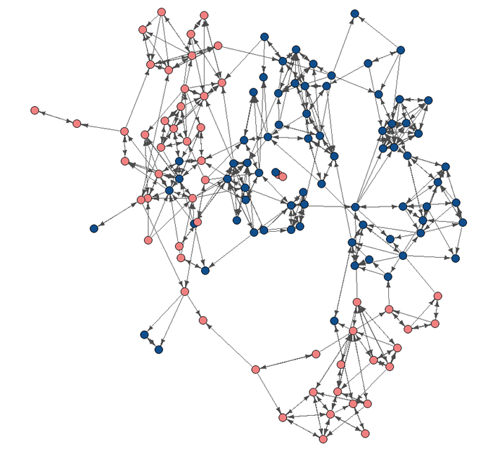
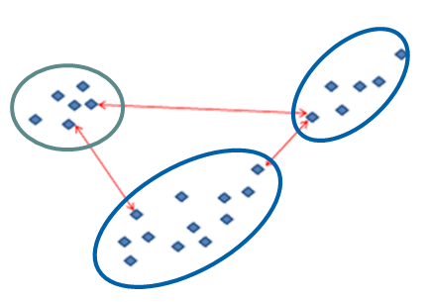
Where does the complexity lie (roughly)?
Internal: within cases
External: processes, relationships

Slide 49

Beyond the module

Slide 50
Assessment due 22 April at 13:00
Make sure research question and proposed method(s) match
The method(s) MUST deal with relevant aspects of complexity that you identify
1/ Compare two methods
What methods could complement each other?
2/ Use one of the methods
Choose question with relevant dataset / model
Be guided by what is possible with your dataset or model
Remember the reader
Explain how the method(s) you choose could be useful, not about answering a research question
Extensions and adjustments have forms
Come and talk to me if unsure

Slide 51

Your reflections
Something(s) you learned in this module that you think is important
Something(s) you learned in this module that you found interesting

Slide 52


The End
Thank you
For being a great group to teach
For taking on something a little different
Please complete the Module Evaluation Questionnaire when you are asked
I don’t find out what you think of the module unless lots of you fill it in

